Slide 1

CS 533 INTRO TO DATA SCIENCE
Michael Ekstrand

Slide 2
PRESENTING DATA

Slide 3
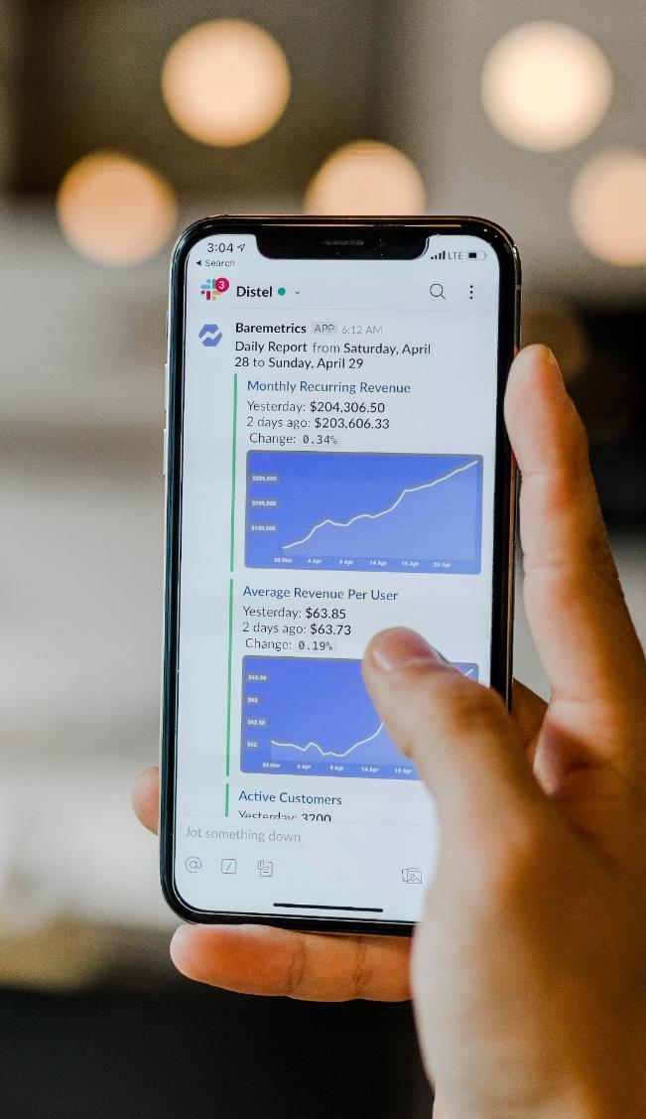
Learning Outcomes (Week)
Create plots for data
Identify the appropriate type of plot for data in question
Read and interpret a plot
Refine a plot to more clearly show data
Write a well-organized notebook to present data analysis
Photo by Austin Distel on Unsplash

Slide 4
Purposes of Data Presentation
Guide reader attention to important results
Focus
Make it easy to ask the key questions
Substantiate results and conclusions
Do so with integrity

Slide 5
Audiences
You’ll need to present data to several audiences:
Yourself
Your collaborators, supervisors, etc.
Expert readers (know subject, not your work)
Decision-makers
The general public

Slide 6
Guiding Questions
What did you seek to find out?
What did you learn?
Why should the reader trust your conclusions?
Presentation with integrity shows the reader what you learned.
Dishonest presentation manipulates them.

Slide 7
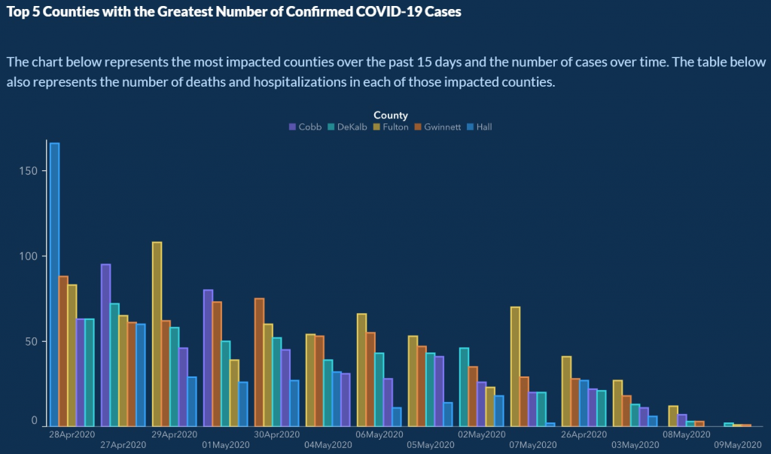

Slide 8
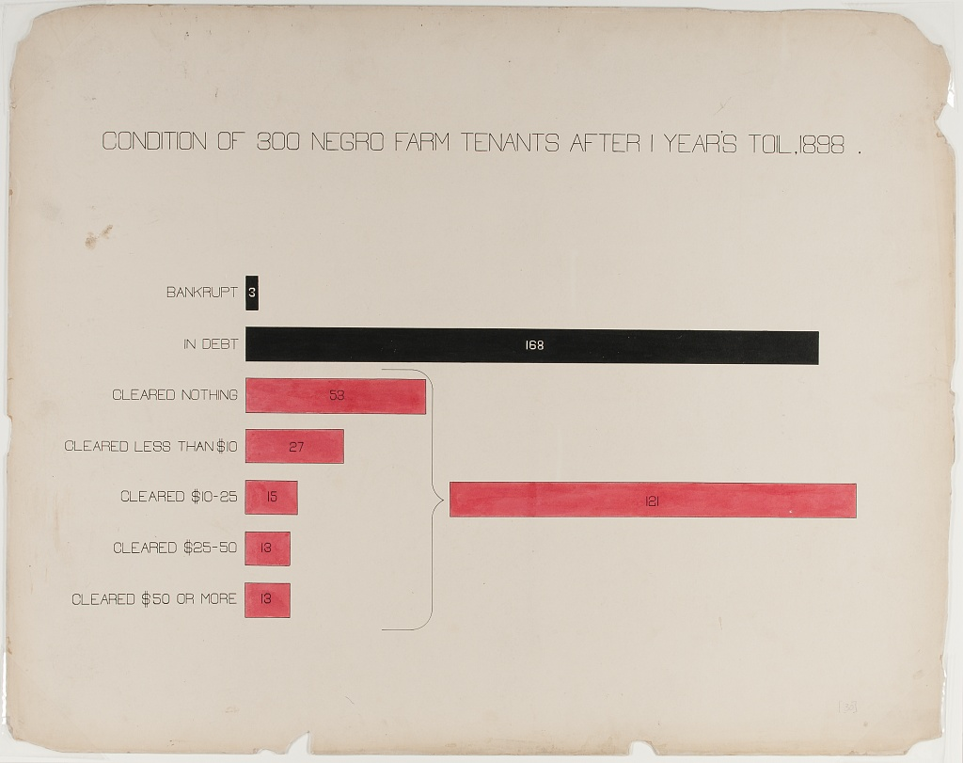
Created by W.E.B. Du Bois for the 1900 Paris Exposition.
From https://www.loc.gov/resource/ppmsca.33892/

Slide 9

Created by W.E.B. Du Bois for the 1900 Paris Exposition.
From https://www.loc.gov/item/2013650445/

Slide 10

Wrapping Up
The goal of good presentation is to guide the reader to what we learned and how we know it.
Effective presentation will highlight the important things without distraction or deception.
Photo by Ben White on Unsplash

